Slide 1


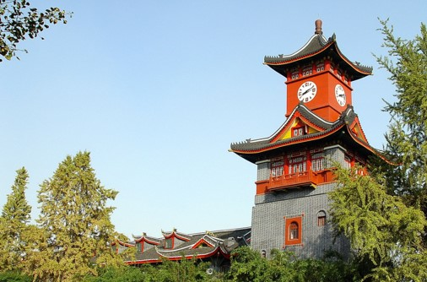
2020
ICAIBD
Spatio-temporal Analysis of Retail
Customer Behavior based on
Clustering and Sequential Pattern Mining
Sizhe Yu
Sichuan University
2020.05.29

Slide 2
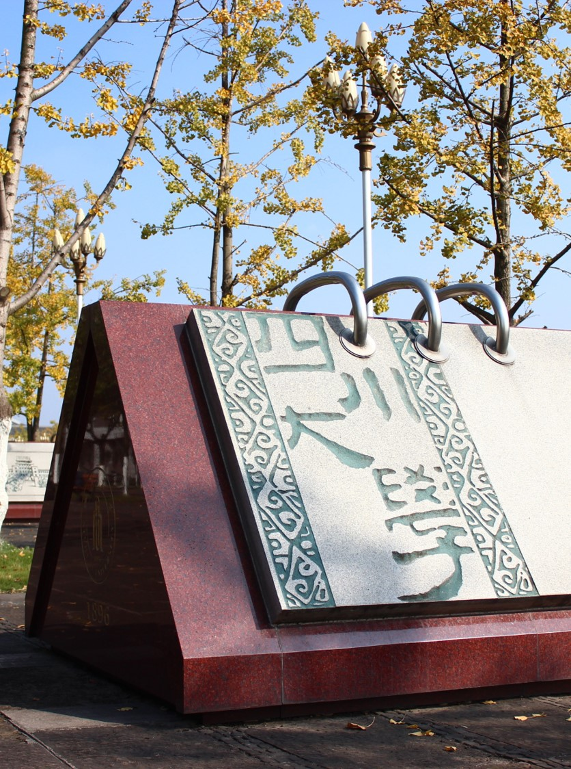
Introduction
01
Research Contents & Innovation
Spatio-temporal Clustering
02
Methodology & Data Processing & Experiments & Results
CONTENTS
Sequential Pattern Mining
03
Methodology & Data Processing & Experiments & Results
04
Conclusion
Significance & Future Work

Slide 3

1
01
PART
ONE
Introduction

Slide 4
Research Contents
01
Spatio-temporal Clustering
02
Sequential Pattern Mining
ST-DBSCAN
S-T distribution of customer purchase behavior
The aggregation of hot-spots
Visualization
PrefixSpan
POI semantic analysis
Characteristics of customer purchase trajectory
The life style of customers

Slide 5
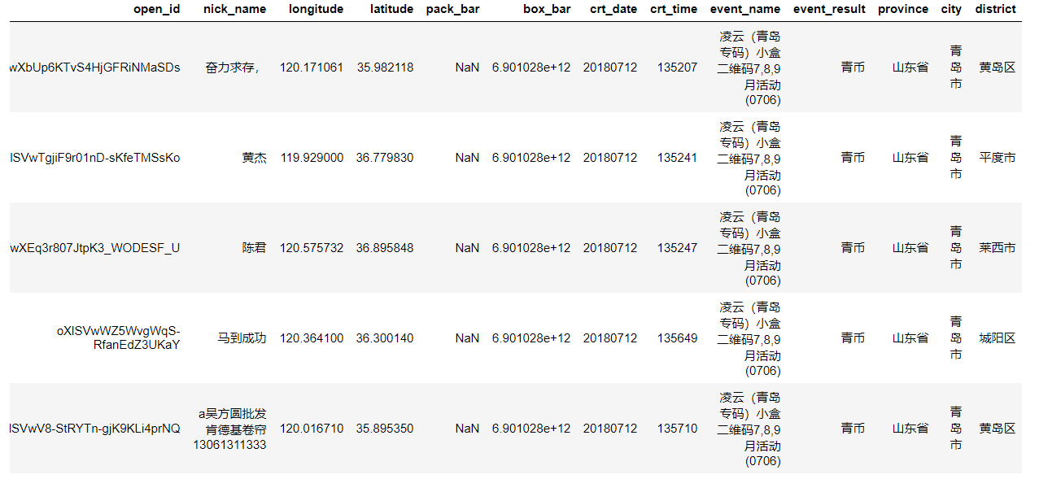
Data Set

Slide 6
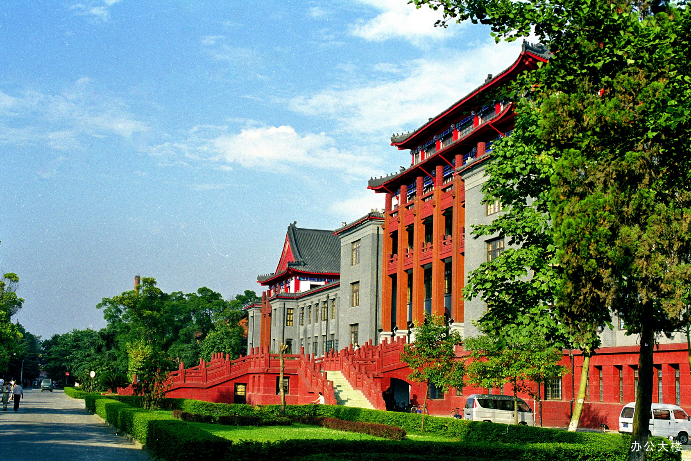
Innovation
Both the two types of analysis have never been touched in previous retail research
Provide a new analytic framework for the academia
Provide some guidelines for customer relationship management in the retail industry.

Slide 7
2
02
PART
TWO
Spatio-temporal Clustering

Slide 8
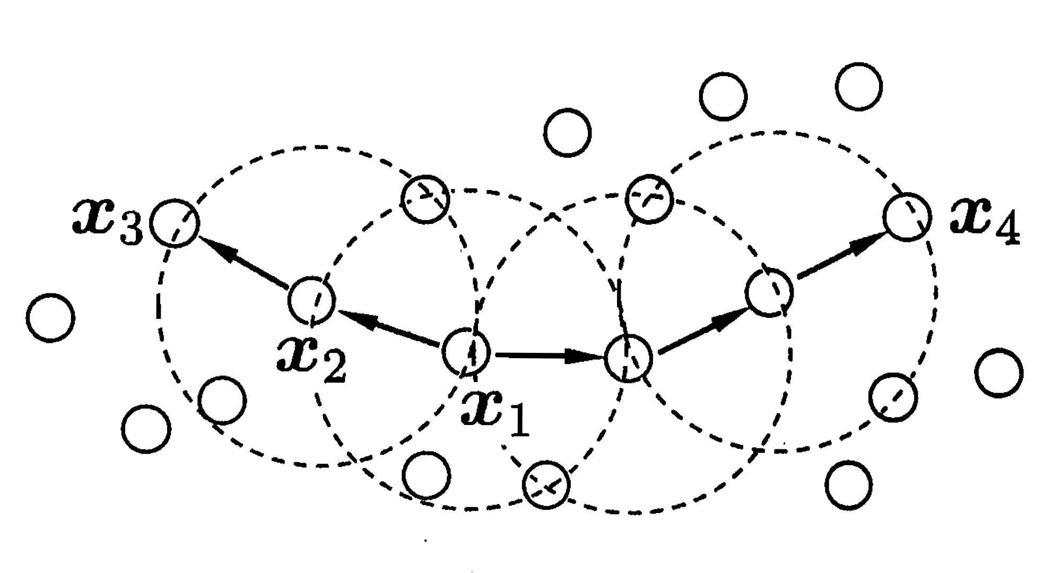
ST-DBSCAN
DBSCAN
Eps1
Eps2
MinPts
Eps
Minpts

Slide 9
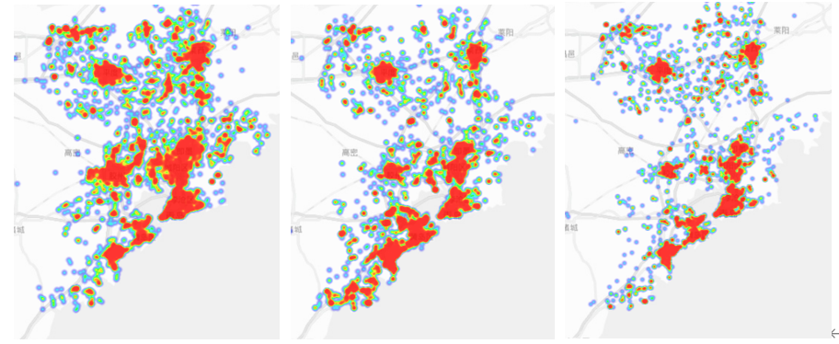
Data Processing & Parameter
All Day
18 p.m.
22 p.m.
Eps1 = 15000
Eps2 = 30
MinPts = 8

Slide 10
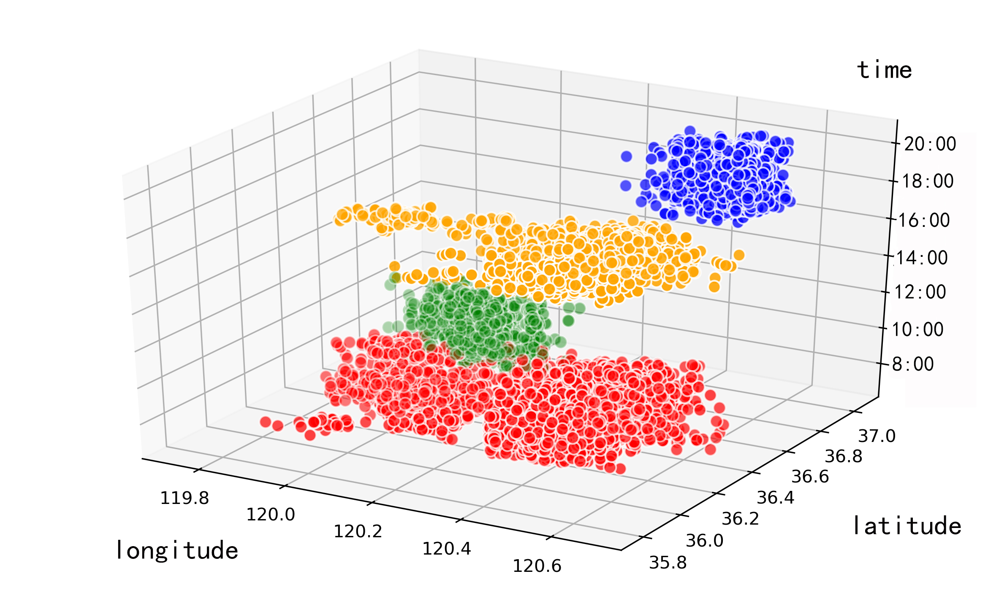
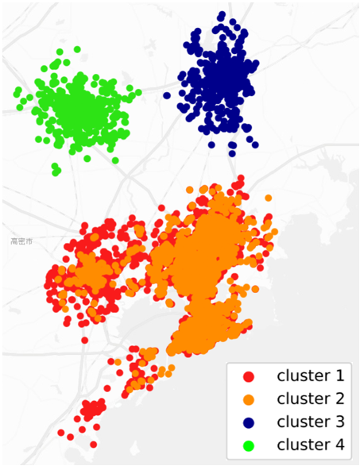
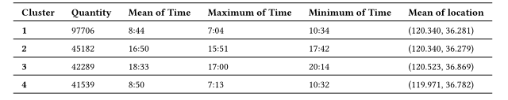
Results

Slide 11
3
03
PART
THREE
Sequential Pattern Mining

Slide 12
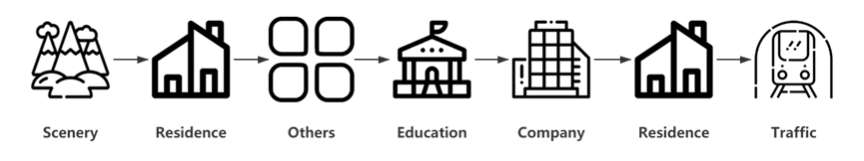
Data Processing
Sequence: A customer’s weekly shopping trajectory

Slide 13
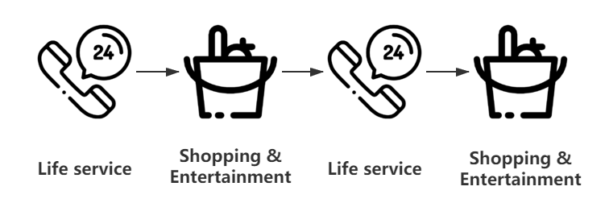
Results
• Pattern 1 : < Life service → Shopping and Entertainment → Life service>
• Pattern 2 : < Shopping & Entertainment → Life service → Shopping & Entertainment>
• Pattern 3 : < Shopping & Entertainment → Food service → Shopping & Entertainment>
• Pattern 4 : < Shopping & Entertainment → Traffic → Shopping & Entertainment>

Slide 14
4
04
PART
FOUR
Conclusion

Slide 15
Conclusion
01
Our Work
02
Future
Spatio-temporal clustering
Sequential pattern mining
Enhance the understanding of customers
Better allocate business resources
Adjust the granularity
Different customer groups

Slide 16

Thanks for your listening
Sizhe Yu
Sichuan University
2020.05.29

